Slide 1
Essential Question:
  What were the major provisions of Wilson’s 14 Points & the Treaty of Versailles?
Notes:
Lesson Plan for Monday, January 26, 2009: Show Mindsparks transparency 4.2 (Wilson drowning), Start notes; Examine Wilson’s 14 Points (activity 38), Examine the provisions of the Treaty of Versailles (activity 39)

Slide 2
Wilson’s Fourteen Points
Wilson believed WW1 presented an opportunity for the USA to take the lead towards world peace:
  Wilson saw moral diplomacy as the antidote to imperialism & military aggression
  Wilson’s plan for peace was the Fourteen Points based on progressive liberalism & improved international relations
A faith in government to solve international problems

Slide 3
The Treaty of Versailles
Austria
Hungary
Yugoslavia
Wilson’s Fourteen Points contained 3 main themes:
  To create new nations out of weakened empires based on “national self-determination”
  To create new internat’l rules: freedom of the seas, no more secret treaties, reduce militarism
  To create a League of Nations to solve future problems
Poland
Czechoslovakia
Turkey
Notes:
21

Slide 4
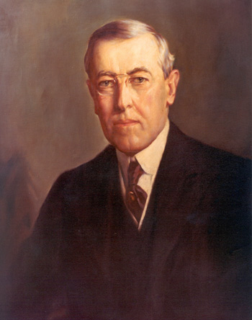
Let’s Look at Wilson’s Fourteen Points

Slide 5
Wilson’s Fourteen Points
Wilson made a mistake by not including any key Republicans in his Paris delegation
Wilson traveled to the Paris Peace Conference in 1919 to help create the Treaty of Versailles:
  He hoped his Fourteen Points would become the framework for the peace treaty
  But, Wilson had to compromise some of his 14 Points if he wanted a League of Nations

Slide 6
Let’s Examine the Major Provisions of the Treaty of Versailles

Slide 7
The Treaty of Paris, 1919
The treaty was a compromise:
  Poland, Czech, Yugoslavia were formed but Germany’s colonies were split up by the victors
  Germany had to accept the “war guilt clause” & pay $33 billion
  The treaty did not mention free trade or freedom of seas
  Despite calls for open covenants, the treaty was drafted in secret
Wilson originally hoped for a “peace without victory”

Slide 8
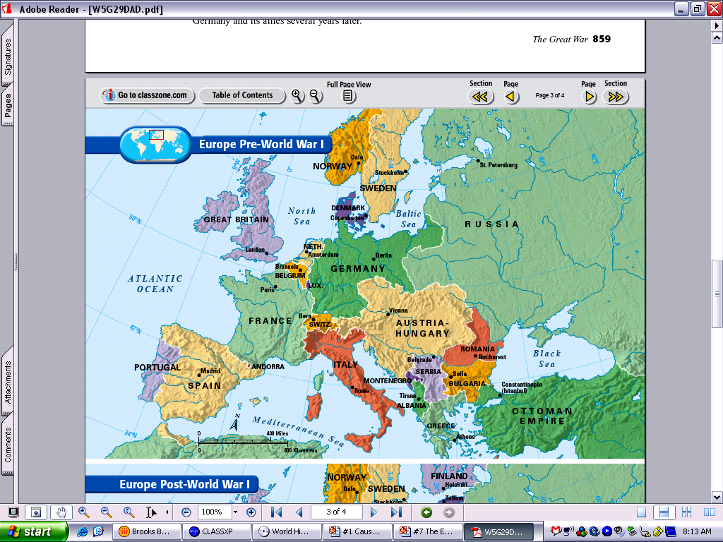
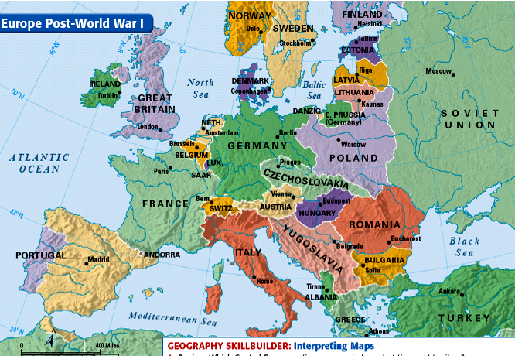
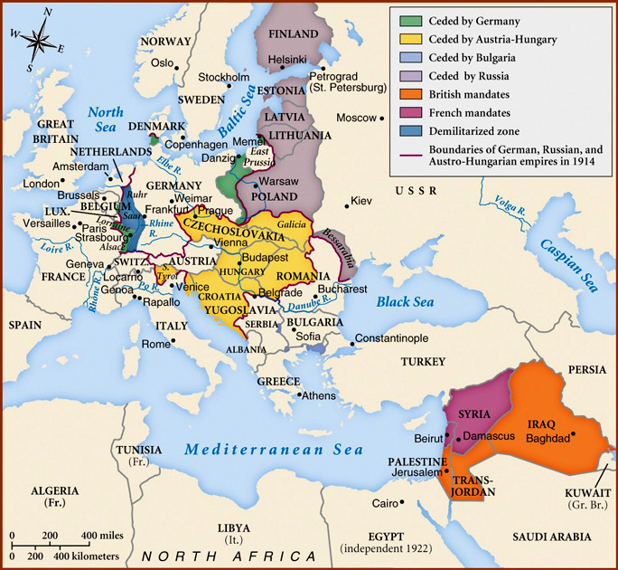
Europe before the war
Europe after the war
New countries!
Divided empires!
New countries!
New countries!
New countries!
New countries!
Divided empires!
New countries!
Post-war changes in the Middle East will have consequences on U.S. history
Russia turns Communist (USSR)

Slide 9
Essential Question:
  Why did the USA refuse to ratify the Treaty of Versailles or join the League of Nations?
Warm-Up Question:
  To what extent was the Treaty of Versailles a reflection of Wilson’s Fourteen Points?
Notes:
Lesson Plan for Tuesday, January 27, 2009: Warm-Up Question, Finish Versailles notes

Slide 10
A Peace of Paris
Article 10
The Members of the League undertake to respect & preserve as against external aggression the territorial integrity and existing political independence of all Members of the League. In case of any such aggression or in case of any threat or danger of such aggression the Council shall advise upon the means by which this obligation shall be fulfilled.
But, the “Big Four” agreed to Wilson’s League of Nations:
  Created a General Assembly of 27 nations & Executive Council
  A Court of International Justice
  Arbitration & economic sanctions would be used to settle conflicts against nations that resort to war
  Article X asked nations to protect each other’s independence
Executive Council consisted of the “Big Four,” Japan, & 4 other elected nations

Slide 11
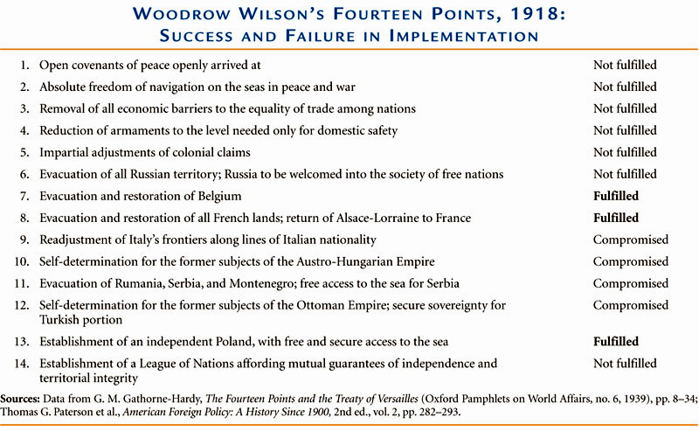

Slide 12
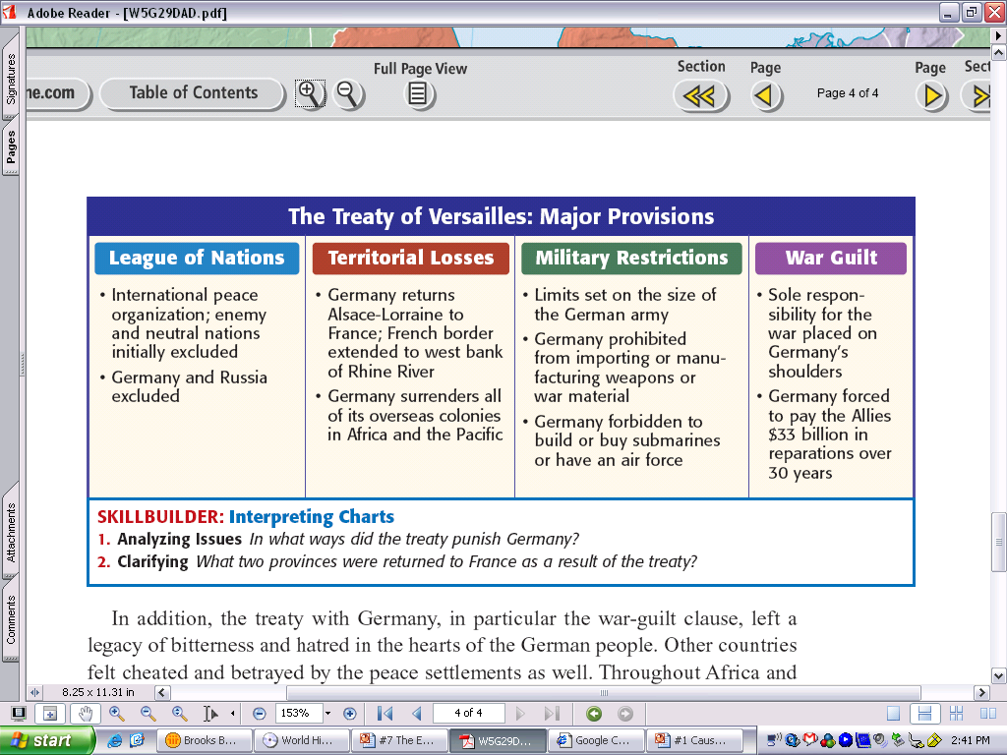
The Treaty of Paris, 1919
On June 28, 1919, the Treaty of Versailles was signed by Germany & officially ended WWI
But, Wilson could not sign the treaty & formally end America’s involvement in WWI; According to Article I of the Constitution, the U.S. Senate has the power to ratify all treaties
Unfortunately for Wilson, many Senators did not like the treaty because of the League of Nations

Slide 13
Read “U.S. Rejection of the Treaty of Versailles”
Examine the many objections to the League of Nations
What should Wilson have done to assure acceptance of the by the Senate of the Treaty of Versailles & League of Nations?

Slide 14
A Peace at Paris
All the major European powers signed the treaty & joined the League, but not the U.S.
Polls showed U.S. support for the treaty, but the Senate wanted to amend the League’s covenant to keep the U.S. from being forced to fight in future foreign wars
Wilson refused to compromise & weaken the League of Nations

Slide 15
Rejection in the Senate
²/3 of the Senate was needed for the U.S. to approve the treaty:
  The “mild reservationists” wanted changes to slightly weaken the League
  The “strong reservationists” led by Henry Cabot Lodge wanted major changes to Article X
  The “irreconcilables” refused to allow the U.S. to join the League
Notes:
22

Slide 16
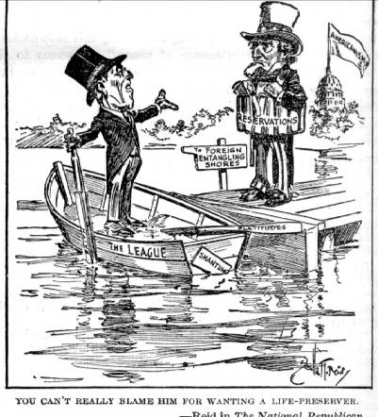

Slide 17
Rejection in the Senate
Senate majority leader Lodge led the attack on the treaty & League:
  Instead of compromising, Wilson tried to pressure the Senate with a cross-country speaking tour
  The tour was popular but ineffective in pressuring Lodge
  During the tour, Wilson had a stroke & remained bedridden
Like he did at the Paris Peace Conference
For the rest of his presidency, Edith Wilson served as de facto president

Slide 18
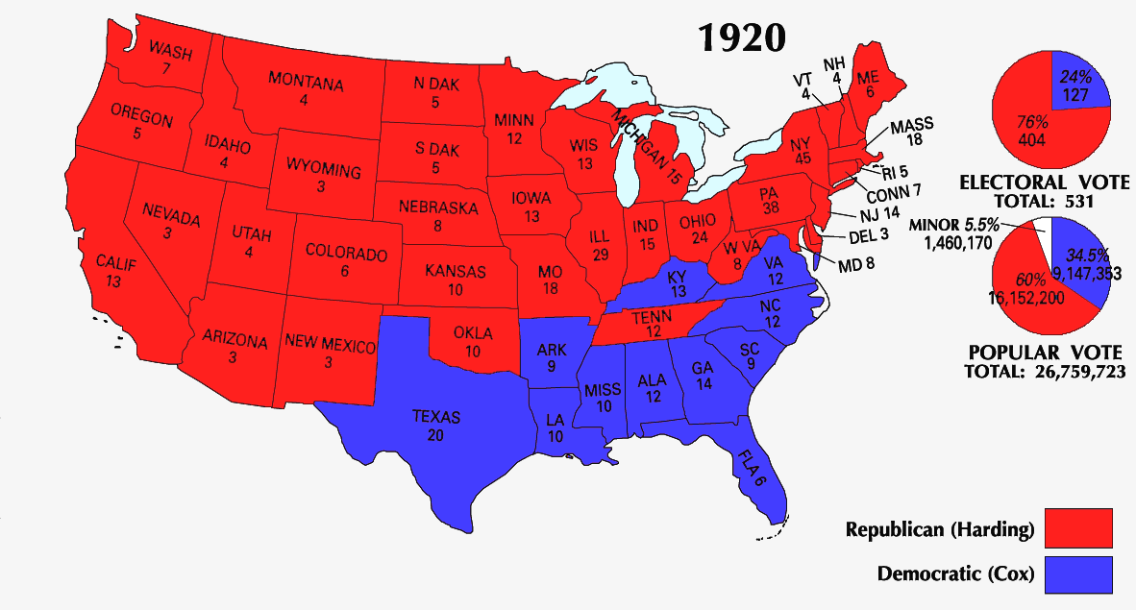
Rejection in the Senate
Wilson’s failure to compromise led the “irreconcilables” & “strong reservations” to defeat the treaty
The United States never signed the Treaty of Versailles nor joined the League of Nations
In 1920, the Republican Warren Harding won in a landslide signaling a “return to normalcy”
“Compromise? Let Lodge compromise… Better a thousand times to go down fighting than to dip your colors to a dishonorable compromise.”
—Woodrow Wilson

Slide 19
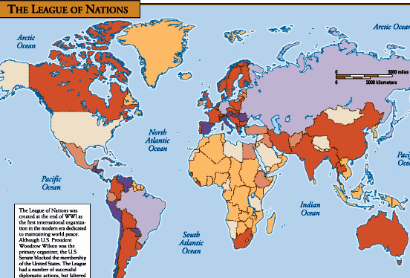
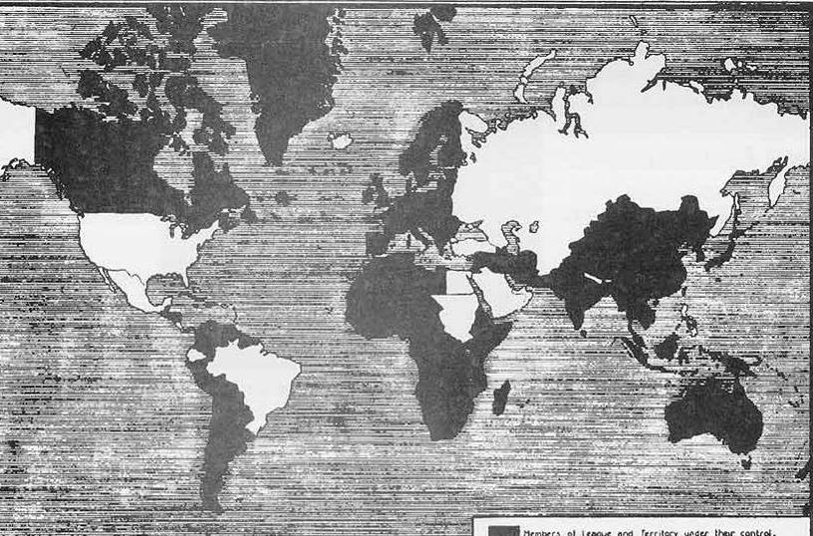
Members of the League of Nations
U.S. signed its own peace treaty with Germany in 1921

Slide 20
Conclusions:
Postwar Disillusionment

Slide 21
Postwar Disillusionment
The war killed “something precious and perhaps irretrievable in the hearts of thinking men and women”
The impact of the Great War:
  The U.S. played a key role the international peace process
  Led to unprecedented economic prosperity & gov’t involvement but killed Progressivism
  To the next generation, the war seemed futile & wasteful
  Americans welcomed President Harding’s return to “normalcy”
This sentiment was driven by a group of authors in France & America calling themselves the “Lost Generation”
A promise “not of heroics but healing; not nostrums but normalcy; not revolutions but restoration”

